Slide 1
System Interface
CS422/522 Lecture 5
10 September 2014
Last updated: 10 September 2014
张义飞 2015

Slide 2
Outline
Recap
Traps, Exceptions, and System Calls
In X86...
An xv6 Example
Hardware Interrupts
Wrap-Up
张义飞 2015

Slide 3
Recap
Page table performance
Xv6 memory initialization
Page faults
Page strategies
张义飞 2015

Slide 4
Outline
Recap
Traps, Exceptions, and System Calls
In X86...
An xv6 Example
Hardware Interrupts
Wrap-Up
张义飞 2015

Slide 5
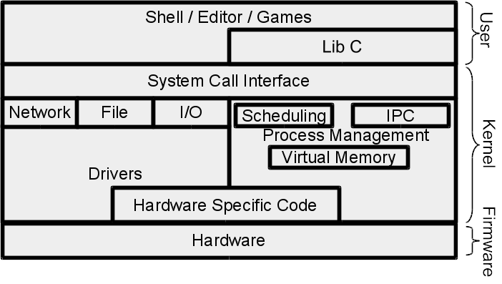
Transitions
Types:
user to kernel - interrupts,
exceptions, traps
kernel to user - return from
interrupts, exceptions, traps
kernel to kernel - context
switch, interrupts
Motivation:
Isolation
Abstraction / transparency
Events / notifications
张义飞 2015

Slide 6
Exceptions and Interrupts
Control transfer from normal flow to handle special events
Exceptions errors or exceptional conditions
  Processor detected: faults, traps, aborts
  Software interrupts
Interrupts asynchronous external event
  Maskable
  Nonmaskable
张义飞 2015

Slide 7
System calls
Userspace accesses service offered by OS.
Categories:
        Process control
        File management
        Device management
        Information
        Communication
        [Protection]
张义飞 2015

Slide 8
CPU and Transitions
The state before, during, and after.
What should stay the same / be different?
  Faults -- everything remains the same
  Traps -- almost everything, increment eip and return value
What happens during?
  Process request
  If valid, return result
  If invalid, kill process or crash kernel
张义飞 2015

Slide 9
Outline
Recap
Traps, Exceptions, and System Calls
In X86...
An xv6 Example
Hardware Interrupts
Wrap-Up
张义飞 2015

Slide 10
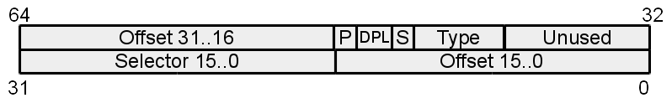
X86 Exceptions and Interrupts
Stored in interrupt descriptor table, IDT
Descriptor format:
Three types:
  Task - Segmentation based management of processes
  Interrupt - mask (hardware) interrupts
  Trap - don't mask interrupts
张义飞 2015

Slide 11
Exceptions
Examples:
Breakpoint
General Protection Fault
Page Fault
Double Fault -- kernel bug
Triple Fault -- kernel bug
张义飞 2015

Slide 12
Interrupts
Keyboard
Hard drive
Mouse
Network card
Spurious -- there was an interrupt, it has since left
System timer
张义飞 2015

Slide 13
Interrupt Table
256 descriptor entries
Some are already occupied by exceptions
OS will maps hardware interrupts (IRQS) to others
We can occupy one or more for system call
张义飞 2015

Slide 14
System Calls
Goal: Increase CPU privilege level and execute OS service
x86 method - assembly instruction int x
When setting the descriptor, the x's descriptor's dpl == 3
cpl > dpl, general protection fault
Passing parameters: stack or registers
张义飞 2015

Slide 15
Task State Segment
Hardware support for process management
Slower than software so largely deprecated / unused
Except: holds kernel (CPL = 0) stack
张义飞 2015

Slide 16
System call overview
Pass parameters, execute int SYSCALL
CPU swaps stacks based upon TSS
Pushes ss, esp, eflags, cs, eip, error code (optional)
May store rest of the cpu state (depends on system call model / compiler)
Execute system call
Set return result, where? register -- eax
Restore registers
execute iret
张义飞 2015

Slide 17
Outline
Recap
Traps, Exceptions, and System Calls
In X86...
An xv6 Example
Hardware Interrupts
Wrap-Up
张义飞 2015

Slide 18
Setting up the IDT
        Handlers
        Building IDT entries
        Setting the IDT
张义飞 2015

Slide 19
Handlers
Make produces a vector.S file from vectors.pl:
2981 # .globl vector0
2982 # vector0:
2983 # pushl $0 # error
2984 # pushl $0 # trap number
2985 # jmp alltraps
张义飞 2015

Slide 20
Pointers to handlers
2988 # # vector table
2989 # .data
2990 # .globl vectors
2991 # vectors:
2992 # .long vector0
2993 # .long vector1
2994 # .long vector2
2995 # ...
张义飞 2015

Slide 21
Creating the IDT
Called from int main...
3071 for(i = 0; i < 256; i++)
3072 SETGATE(idt[i], 0, SEG_KCODE<<3, vectors[i], 0);
3073 SETGATE(idt[T_SYSCALL], 1, SEG_KCODE<<3,
vectors[T_SYSCALL], DPL_USER);
张义飞 2015

Slide 22
Setting the IDT
3081 lidt(idt, sizeof(idt));
张义飞 2015

Slide 23
An Example Using SBRK
sbrk allocates and frees memory for a process
User doesn't typically call, instead uses: malloc and free
sbrk(int increment)
  increment > 0 -- allocate more memory
  increment == 0 -- determine upper memory boundary
  increment < 0 -- free memory
  In xv6 only > 0 is supported
张义飞 2015

Slide 24
Calling SBRK
new_va = sbrk(1000);
张义飞 2015

Slide 25
Entering the Kernel
Enters usys.S and a function like:
.globl sbrk
sbrk:
movl $SYS_SBRK, %eax
int $T_SYSCALL
ret
张义飞 2015

Slide 26
Entering the Trap Handler
.globl vector64
vector64:
pushl $0 # error
pushl $64 # trap number
jmp alltraps
张义飞 2015

Slide 27
Initial Trap Handling
3003 .globl alltraps
3004 alltraps:
3005 # Build trap frame.
3006 pushl %ds
3007 pushl %es
3008 pushl %fs
3009 pushl %gs
3010 pushal
3011
3012 # Set up data and per−cpu segments.
3013 movw $(SEG_KDATA<<3), %ax
3014 movw %ax, %ds
3015 movw %ax, %es
3016 movw $(SEG_KCPU<<3), %ax
3017 movw %ax, %fs
3018 movw %ax, %gs
张义飞 2015

Slide 28
Entering the C Trap Handler
3020 # Call trap(tf), where tf=%esp
3021 pushl %esp
3022 call trap
张义飞 2015

Slide 29
The C Trap Handler
3101 trap(struct trapframe *tf)
3102 {
3103 if(tf−>trapno == T_SYSCALL){
3104 if(proc−>killed)
3105 exit();
3106 proc−>tf = tf;
3107 syscall();
3108 if(proc−>killed)
3109 exit();
3110 return;
3111 }
...
张义飞 2015

Slide 30
System Call Handler
3375 syscall(void)
3376 {
3377 int num;
3378
3379 num = proc−>tf−>eax;
3380 if(num > 0 && num < NELEM(syscalls) && syscalls[num]) {
3381 proc−>tf−>eax = syscalls[num]();
3382 } else {
3383 cprintf("%d %s: unknown sys call %d\n",
3384 proc−>pid, proc−>name, num);
3385 proc−>tf−>eax = −1;
3386 }
3387 }
...
张义飞 2015

Slide 31
Executing the system call
3451 sys_sbrk(void)
3452 {
3453 int addr;
3454 int n;
3455
3456 if(argint(0, &n) < 0)
3457 return −1;
3458 addr = proc−>sz;
3459 if(growproc(n) < 0)
3460 return −1;
3461 return addr;
3462 }
张义飞 2015

Slide 32
growproc
Wrapper around growproc
growproc actually supports increasing or decreasing memory
growproc wraps allocuvm / deallocuvm
allocuvm / deallocuvm wrap kalloc / kfree with proper va to pa mappings
张义飞 2015

Slide 33
Return to User
3381 proc−>tf−>eax = syscalls[num]();
...
3023 addl $4, %esp
3024
3025 # Return falls through to trapret...
3026 .globl trapret
3027 trapret:
3028 popal
3029 popl %gs
3030 popl %fs
3031 popl %es
3032 popl %ds
3033 addl $0x8, %esp # trapno and errcode
3034 iret
张义飞 2015

Slide 34
Calling SBRK
new_va = sbrk(1000);
// new_va should be + 1000 bytes from beyond the previous limit
张义飞 2015

Slide 35
Outline
Recap
Traps, Exceptions, and System Calls
In X86...
An xv6 Example
Hardware Interrupts
Wrap-Up
张义飞 2015

Slide 36
Hardware Interrupts
Notification of an event from hardware
EFLAGS-IF -- set = enabled, unset = disabled
Example system timer:
  Set to tick off at some fixed time interval -- 10 ms
  Every 10 ms, interrupt generated
  In kernel -- IF = 0
  In user -- IF = 1
  When triggered, causes trap
  Trap handler causes switching to a new process
  Continue execution of resumed process
张义飞 2015

Slide 37
Hardware Interrupts Interface
CPU delegates to APIC (advanced programmable interface
Upto 15 different entries
Connect directly to CPU trap numbers
Mapping setup by calls to APIC
After each hardware interrupt, must reset state:
send an EOI (end of interrupt) or no more interrupts
张义飞 2015

Slide 38
Alternatives to Hardware Interrupts
Consider events versus polling
Interrupts would be events
Could we implement all hardware interrupts as polling?
Hard to enforce time sharing: A good process might yield, but a malicious process might never yield
Performance: each poll attempt requires a user to kernel, kernel to user transition
张义飞 2015

Slide 39
Outline
Recap
Traps, Exceptions, and System Calls
In X86...
An xv6 Example
Hardware Interrupts
Wrap-Up
张义飞 2015

Slide 40
Office Hours Change
After today, Wednesday's office hour cancelled. New office hour Tuesday 1-2 PM
张义飞 2015

Slide 41
Presentation Days
During the semester between 3 to 5 days of paper presentations
Bad grade begone
List of papers forthcoming
Student presenting does not need to send review
May be (should be) presented in the Tuesday seminars for bonus bad grade begone
张义飞 2015

Slide 42
Lab 0, Lab 1, Lab 2
Lab 0 and Lab 1 due tonight before 11:59 PM for credit
Lab 2 must due tomorrow before 11:59 PM for full credit
Lab 2 has 3 late days, each reduces final score by 10%
张义飞 2015

Slide 43
Lab 3A: User Environments
        Due: 9/18 @ 11:59 PM
        Building environments (processes)
        Implementing a trap handler
张义飞 2015

Slide 44
Next Time
Monday 1:00PM
Processes
张义飞 2015

